Slide 1

Please read this before using presentation
This presentation is based on the content presented at the 2019 Nano diesel particulate matter (nDPM) in July 2019.
Department of Mines, Industry Regulation and Safety (DMIRS) supports and encourages reuse of its information (including data), and endorses use of the Australian Governments Open Access and Licensing Framework (AusGOAL)
This material is licensed under Creative Commons Attribution 4.0 licence. We request that you observe and retain any copyright or related notices that may accompany this material as part of attribution. This is a requirement of Creative Commons Licences.
Please give attribution to Department of Mines, Industry Regulation and Safety, 2019.
For resources, information or clarification, please contact: SafetyComms@dmirs.wa.gov.au or visit www.dmirs.wa.gov.au/ResourcesSafety

Slide 2

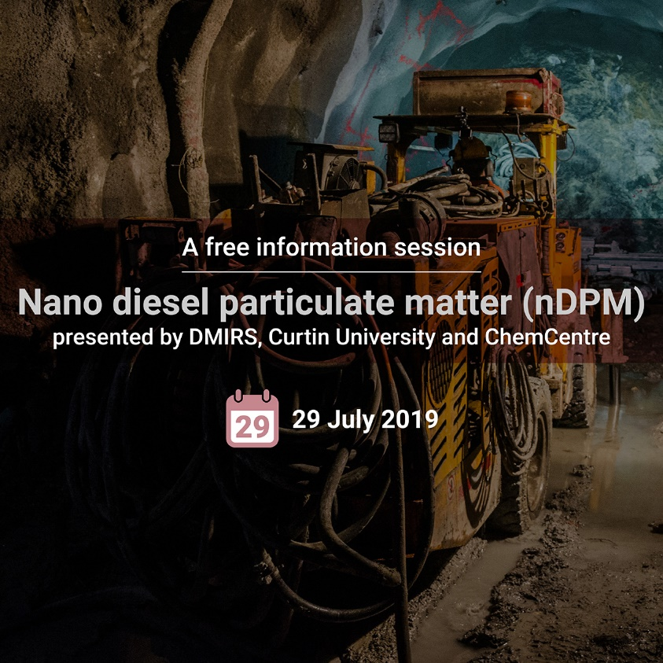
2019 Nano diesel particulate matter (nDPM) Forum

Slide 3

Exposure to Nano Diesel Particulate Matter (nDPM) and health impacts in underground hard rock miners in Western Australia
Associate Professor Alison Reid,
Ms Mengran Du, Associate Professor Ben Mullins
Curtin University, Western Australia

Slide 4
Aims
The overall aim of this study was to ascertain the health effects of exposure to diesel particulate emissions on underground and above ground miners of Western Australia.
a. the prevalence of respiratory symptoms (cough and phlegm, breathlessness, airflow obstruction, history of asthma and atopy).
b. changes in lung function across the working shift in relation to diesel exposure and smoking.
c. changes in level of urinary 1-hydroxypyrene (1-OHP) and 1-Aminopyrene (1-AP) across the working shift in relation to diesel exposure and smoking.
d. DNA methylation in blood in relation to diesel exposure estimates and smoking.
e. levels of blood pressure in relation to diesel exposure estimates and smoking.
f. determine which measures of DEE were more closely correlated with the above – e.g. NOx, EC, Particle Number.

Slide 5
Methods
20 surface, 80 underground
5 recruited per shift.
Start of shift
Questionnaire on respiratory health, smoking, occupational history. Blood pressure, height, weight, lung function test, urine sample
Fitted with exposure monitors
End of shift
Lung function test (with bronchodilator), urine sample, blood sample, questionnaire about tasks undertaken that day and a task diary.

Slide 6
Tests
Urine
1-Aminopyrene (1-AP)
1-Hydroxyprene (1-OHP)
Lung function
FEV1, FVC, FEV1/FVC
Across shift change in lung function
(FEV1Post-shift - FEV1Pre-shift)/ FEV1Pre-shift *100
Blood
DNA Methylation

Slide 7

Materials and Methods – DNA Methylation
Illumina Epic Array (~850K DNA methylation sites)
80 participants (71 underground, 9 surface)
Beta-mixture-quantile normalization (BMIQ)
Batch effects and estimated cell count regressed against DNA methylation values and residulized
Linear model with CpG as outcome run on 8 phenotypes
  surface/underground, Years in Mining Industry, Shift Work, NOx, Particle Count, EC, Particle Size, Total VOCs
  accounting for age, sex, smoking
Differentially methylated regions identified with DMRcate and a conservative Stouffer cut-off<0.05
Gene enrichment analysis done with MissMethyl with only variants with p-value <0.001

Slide 8
Number of participants who completed tests
Tests | Underground (N=80) | Surface (N=20) | Total (N=100)
Questionnaires | 79 | 20 | 99
Height | 80 | 20 | 100
Weight | 80 | 20 | 100
Blood pressure | 80 | 20 | 100
Post shift blood sample | 72 | 18 | 90
Pre-shift lung function | 80 | 20 | 100
Post-shift lung function | 77 | 18 | 95
Pre-shift urine | 80 | 20 | 100
Post-shift urine | 80 | 20 | 100

Slide 9
Demographic/work history/respiratory symptoms
Underground miners
Fewer years overall working in the mining industry (7.8 v 12.5 years)
Higher systolic blood pressure (142.6 mmHg v 135.5 mmHg)
More current smokers (37.5% v 15%) but difference not statistically significant
No other statistically significant differences between the groups
85% of underground and 81% of above ground miners overweight or obese.
Notes:
Overweight and obese higher than in Australian population – where 2/3rds of adults are overweight or obese
Levels of smoking higher in miners too than Australian population (14.5% overall of 17% among Males).

Slide 10
Levels of exposure between underground and surface miners
Exposures | Underground (median, IQR) | Surface(median, IQR) | Total (median, IQR) | p
EC (μg/m³) | 56.5 (50.6) | 1.38 (0) | 43.73 (64.1) | <0.001
VOCs (μg/m³) | 111.5 (81.2) | 51.2 (21.3) | 94.6 (82.6) | <0.001
NO₂ (μg/m³) | 0.33 (0.45) | 0.02 (0.01) | 0.25 (0.44) | <0.001
Particle number (pt/ccm) | 52740 (49776) | 8764 (15340) | 40853 (48074) | <0.001
Particle size (nm) | 57.8 (19.9) | 50.4 (7.8) | 54.2 (16.7) | 0.003
Notes:
Exposure levels were higher all measures in underground compared with above ground miners.
There was no difference in exposure between day and night shift.

Slide 11
Highest exposures by job type.
Job title | N | EC (median) (μg/m³) | VOCs (median) (μg/m³) | NO₂ (median) (μg/m³) | Particle number (median) (pt/ccm) | Particle size (median) (nm)
Service crew | 8 | 89.5 | 93.8 | 0.7 | 85,400 | 61
Driller / offsider | 15 | 68.9 | 93.3 | 0.4 | 95,100 | 50
Jumbo operator | 7 | 65.4 | 192.4 | 0.3 | 54,800 | 66
Bogger operator | 9 | 57.9 | 136.4 | 0.7 | 41,500 | 65
Nipper | 3 | 41.3 | 189.9 | 0.5 | 82,100 | 57
Exposure standards: EC is 100 μg/m³ 8 hour TWA, NO₂ is 5600 μg/m³ 8 hour TWA
Notes:
These were the three highest jobs n terms of exposure to EC.
Jobs with the highest exposure to VOCs were jumbo operators, nippers and boilermakers.
jobs with the highest exposure to NO_{x} were service crew operators, bogger operators and nippers; jobs with the highest exposure to particle number were service crew operators, drillers or offsiders and nippers.
. There was little change in exposure to particle size across the different jobs
NB – the AIOH exposure standard for diesel is 100 um over a 12 hour shift

Slide 12
Cross shift changes in lung function – Forced Expiratory Volume in 1 second
 | Underground | Surface | P-value
 | Mean | Mean
FEV₁ Litres
Pre-shift | 4.04 | 4.00 | 0.828
Post-shift | 3.97 | 3.90 | 0.683
% difference | -2.51 | 0.01 | 0.009
P-value | <0.001 | 0.779
Notes:
There were no statistically significant differences in the pre or post shift mean FEV₁, between underground and above ground miners. However, the cross-shift decreases (percent difference in FEV₁ among underground miners were statistically significantly larger than those of above ground miners
For mean FEV1 there was a decrease of 100 mls across the working shift in underground miners, equating to a 2.65% reduction.

Slide 13
Cross shift changes in lung function – Forced Vital Capacity
 | Underground | Surface | P-value
 | Mean | Mean
FVC Litres
Pre-shift | 5.18 | 5.08 | 0.713
Post-shift | 5.11 | 4.90 | 0.348
% difference | -2.03 | -1.12 | 0.256
P-value | <0.001 | 0.111
Notes:
There were no statistically significant differences in the pre or post shift mean FVC or cross shift decreases, between underground and above ground miners.

Slide 14
Cross shift changes in lung function – FV1/FVC
 | Underground | Surface | P-value
 | Mean | Mean
FEV₁/FVC
Pre-shift | 0.78 | 0.79 | 0.533
Post-shift | 0.78 | 0.80 | 0.168
% difference | -0.050 | 1.16 | 0.007
P-value | 0.073 | 0.019
Notes:
There were no statistically significant differences in the pre or post shift mean FEV₁/FVC ratio, between underground and above ground miners. However, the cross-shift decreases (percent difference in FEV₁/FVC ratio among underground miners were statistically significantly larger than those of above ground miners

Slide 15
Cross shift changes in lung function
Exposure | FEV₁% Coef | FVC % Coef | FEV₁/FVC% Coef
Underground | -2.33* | -0.89 | -1.48*
Former Smokers | 0.09 | -0.17 | 0.28
Current Smokers | -0.7 | -0.15 | -0.57
Respiratory symptoms | 0.24 | 0.77 | -0.53
Years in mining | 0.01 | 0.00 | 0.01
Shift on swing | -0.01 | -0.01 | 0.01
*p<0.05
Notes:
Compared with above ground miners, the cross shift changes in FEV₁were significantly greater in underground miners after adjusting for smoking status, total years in mining industry and shift on swing.

Slide 16
Cross shift changes in lung function by type of exposure
Exposure@ | FEV₁% Coef | FVC % Coef | FEV₁/FVC Coef
EC (μg/m³) | -0.58* | -0.24 | -0.36*
VOCs (μg/m³) | -1.31 | -1.08 | -0.25
NO_{x} (μg/m³) | -1.41* | -0.76 | -0.68
Particle number (pt/ccm) | -1.88 | -0.38 | -1.53*
Particle size (nm) | 2.55 | 4.62 | -2.13
LDSA | -1.61 | -0.35 | -1.27*
@all exposures have been log10 transformed; *p<0.05
Notes:
Elemental carbon after adjusting for smoking status, total years in mining industry and shift on swing, was statistically significantly negatively associated with cross shift changes in FEV₁ and changes in FEV₁/FVC. So, with every tenfold increase in EC, the cross shift change in FEV₁ decreased by 0.58%.
Exposure to NO_{x} (μg/m³) was also negatively associated with the changes in FEV₁, wherein with every tenfold increase in NO_{x} the cross shift change in FEV₁ decreased by 1.41%.
Similarly, particle number and LDSA were significantly associated with a cross shift decrease in FEV1/FVC.

Slide 17
Pre-and post-shift urinary 1-AP and 1-OHP by smoking status
Biomarker | Never | Former | Current | p
 | Mean | Mean | Mean
Pre-shift 1-AP | -0.17 | -0.35 | -0.03 | 0.621
Post-shift 1-AP | 0.03 | 0.02 | 0.33 | 0.485
Pre-shift 1-OHP | -0.79 | -0.74 | -0.65 | 0.091
Post-shift 1-OHP | -0.71 | -0.67 | -0.48 | 0.012
Notes:
Pre and post-shift urinary 1-AP and pre-shift urinary 1-OHP did not vary statistically significantly by smoking status. However, post-shift urinary 1-OHP did vary statistically significantly by smoking status. Post-shift Urinary 1-OHP was statistically significantly higher among current smokers than former and never smoking miners

Slide 18
Comparisons of pre- and post-shift 1-AP and 1-OHP
 | Underground (median) | Above ground (median) | Total (median) | p
1-AP (µg/g creatinine)
Pre-shift | 3.14 | 0.02 | 2.71 | 0.035
Post-shift | 4.21 | 0.02 | 3.65 | 0.010
P | <0.001 | 0.330 | <0.001 | -
1-OHP (µg/g creatinine)
Pre-shift | 0.16 | 0.09 | 0.14 | 0.270
Post-shift | 0.21 | 0.09 | 0.20 | 0.017
P | <0.001 | 0.441 | <0.001 | -
Notes:
Both the pre-shift and post-shift median concentration of 1-AP in underground miners was statistically significantly higher than that of the above ground miners. Furthermore, underground miners’ median concentration of 1-AP increased significantly across the working shift, while above ground miners’ median concentration of 1-AP did not.
For 1-OHP, the median concentration between underground miners and above ground miners was statistically significantly different at the end of shift. Furthermore, there was a statistically significant increase in the concentration 1-OHP across the shift in underground miners.
The changes in 1-AP and 1-OHP across a working shift in above ground miners were not statistically significant

Slide 19
Association@ between 1-AP & 1-OHP and type of exposure~
Effects | 1-AP | 1-OHP
 | β (95% CI) | β (95% CI)
EC | 0.42 (0.08, 0.76)* | 0.05 (-0.03,0.14)
VOCs | 1.18 (0.13,2.23)* | 0.40 (0.15, 0.64)*
NO_{x} | 0.38 (-0.02, 0.79) | 0.09 (-0.01, 1.19)
Particle number | 0.56 (-0.12, 1.23) | 0.18 (0.01, 0.34)*
Particle size | 1.50 (-1.32, 4.32) | -0.29 (-0.99, 0.41)
@adjusted for age, sex, smoking status, body mass index, years in mining and shift on swing
~log10 transformed *p-value <0.05
Notes:
Compared with the pre-shift, the level of 1-AP and 1-OHP was statistically significantly increased at the post-shift.
The positive associations between EC and 1-AP were statistically significant when controlled for participants’ age, sex, BMI, smoking status, years in mining and shift on swing. For every 10-fold increase in EC led to a 2.63 (10^{0.42}) times increase in 1-AP. However, the association between 1-OHP and EC was not statistically significant after adjusting for confounding factors. Furthermore, current smoking was statistically significantly associated with an increase in 1-OHP but not 1-AP.
We also found both urinary biomarkers positively associated with the concentration of VOCs. For every 10-fold increase in VOCs the level of 1-AP increased by 15.14 times and 1-OHP by 0.51 times.
We also found a statistically significant association between particle number and 1-OHP. For every 10-fold increase in particle number there was a corresponding 1.51 times increase in 1-OHP. Similarly, current smoking had a positive association with 1-OHP, but not with 1-AP

Slide 20
Results: DNA Methylation
Identified 41 differentially methylated sites in seven phenotypes after correction for multiple testing using a conservative Bonferoni correction (p<5.88E-9)
  Above/Below Ground, n=3 sites
  Years in Mining, n=6 sites
  Shiftwork, n=8 sites
  Particle Count, n=4 sites
  DPM, n=4 sites
  Particle Size, n=13 sites
  Total VOCs, n=3 sites
29 sites were in known gene regions and 12 were intergenic
  There was no overlap for genes across these seven phenotypes.
  Twelve of these 29 genes were associated with known chronic diseases including cancer (3 genes, cardiovascular disease (3 genes), and epilepsy (2 genes)
Of particular interest is the site, cg19228537, in the gene ATG10 that is associated with anthracosis and particle size.
  Milder form of interstitial lung diseases caused by the inhalation of certain dusts and the lung tissue’s reaction to the dust.

Slide 21
Results: Differentially Methylated Regions
Search for genomic regions enriched for epigenetic signal
12 Differentially methylated regions were identified as significant after correction for multiple testing.
  6 of these regions were associated with Above/Below Ground group
  3 regions were associated with shiftwork
  2 regions with total VOCs
  1 region with particle size
7 of these regions were in or spanned genes
4 of these gene regions have been previously implicated in cancer and 2 are involved in immune function

Slide 22
Results: Gene Set Enrichment Analysis
Search for biological or molecular functions that are associated with specific phenotypes
Among the 8 phenotypes only NOx had any gene ontologies associated with it after adjusting for multiple testing with a false discovery rate <0.05.
These included 19 gene ontology biological pathways associated with molecular function and 24 with biological processes.
The top pathway associated with NOx was “transcriptional activator activity” with a false discovery rate p-value=0.000013

Slide 23
Discussion - summary of main findings
Levels of exposure to diesel engine exhaust similar or lower than that reported in the literature
Underground miners had greater declines in lung function across the shift than above ground miners
Declines in lung function related to exposure to DPM, specifically NO_{x} and particle number
Pre- and post-shift levels of 1-AP and post-shift level of 1-OHP higher in underground than above ground miners
Levels of both urinary biomarkers increased in underground miners across the shift
Increase in 1-AP across the shift was associated with exposure to VOCs
High number of smokers and overweight/obese

Slide 24
Lung function declines across the shift
70 ml (-2.51%) decrease in FEV1 across the shift –falls within the normal range of variation of repeat tests (150ml)
However lung function decline was significantly greater in underground workers (who had higher exposures) AND
Declines observed after those with a respiratory disorder removed from the analysis – which further signals an association with exposure
Lung function decline significantly related to increasing exposure to EC, NO_{x} and particle number (pt/ccm).

Slide 25
Urinary biomarkers
Levels of 1-AP and 1-OHP increased across the shift in underground miners and the increase was statistically significantly associated with exposure to VOCs.
Similar findings reported elsewhere.
Suggests the exposure is absorbed systemically. Not clear what (if any) health implications are related to increased urinary levels of these biomarkers.
1-OHP associated with current tobacco smoking. Can also be associated with other factors, e.g. diet, sitting near an open fire.
1-AP may be a truer measure of exposure to diesel in high smoking populations.

Slide 26
DNA Methylation
First study to look at epigenome-wide association among several phenotypes related to the mining industry.
Identified several sites and regions that are associated with the investigated phenotypes using highly conservative cut-offs for statistical significance.
Some of these identified sites and regions have been previously associated with chronic disease including cancer.
Further work focussed on both pre and post exposure should be considered along with increased sample size.

Slide 27
Conclusion
Decreases in lung function and increases in levels of urinary biomarkers across the shift were observed in underground miners, and were associated with exposure.
Epi-genome wide association identified several sites and regions associated with mine work characteristics and DEE exposure.

Slide 28
Acknowledgements
Professor Bill Musk, Dr Peter Franklin, Dr Nita Sodhi-Berry, Professor Nick de Klerk – School of Population and Global Health, University of Western Australia
A/Professor Graham Hall, Telethon Kids Institute and Curtin University
Dr Philip Melton, Centre for Genetic Epidemiology UWA/Curtin
Dr Novak Elliott, School of Public Health, Curtin University

