Slide 1
Please read this before using presentation
This presentation is based on content presented at the Mines Safety Roadshows held in 2012 and 2013
It is made available for non-commercial use (e.g. toolbox meetings, OHS discussions) subject to the condition that the PowerPoint file is not altered without permission from Resources Safety
Supporting resources, such as brochures and posters, are available from Resources Safety
For resources, information or clarification, please contact:
  RSDComms@dmp.wa.gov.au
  or visit
  www.dmp.wa.gov.au/ResourcesSafety

Slide 2
Fatigue, shift structures and working hours

Slide 3
What are the top ten priority issues for 2013-14?
Safety culture
Risk management training
Principal hazard management plans (PHMPs)
Safety in design
Maintenance
Construction
Management and supervision
Safety and health representatives
Exploration
Fatigue prevention and management
Notes:
Fatigue prevention and management is still one of Resources Safety’s priority issues for 2013 - 2014, and is likely to be an ongoing issue.

Slide 4
Risk underestimated
  Fatigue
Reduced coordination
Inattention
  Affects safety performance
Decreased awareness
  Hazard
Absent-mindedness
Slower reactions
  Prevent and manage
Reduced ability to process information
Memory lapses
Notes:
So, what it fatigue? It is generally considered to be a decline in mental and/or physical performance that results from prolonged exertion, sleep loss and/or disruption of the internal clock.
It is also related to workload, in that workers are more easily fatigued if their work is machine-paced, complex or monotonous.
Fatigue results in: (click – bullet points will start to appear on screen one by one)
memory lapses
reduced ability to process information
absent-mindedness
decreased awareness
inattention
reduced coordination
and the list goes on but importantly underestimation of risk is there too.
So it affects:
safety performance (click)
and therefore needs to treated as a hazard (click)
and be prevented, managed and controlled (click)
like other hazards, as part of the duty of care responsibility of the employer and workforce

Slide 5
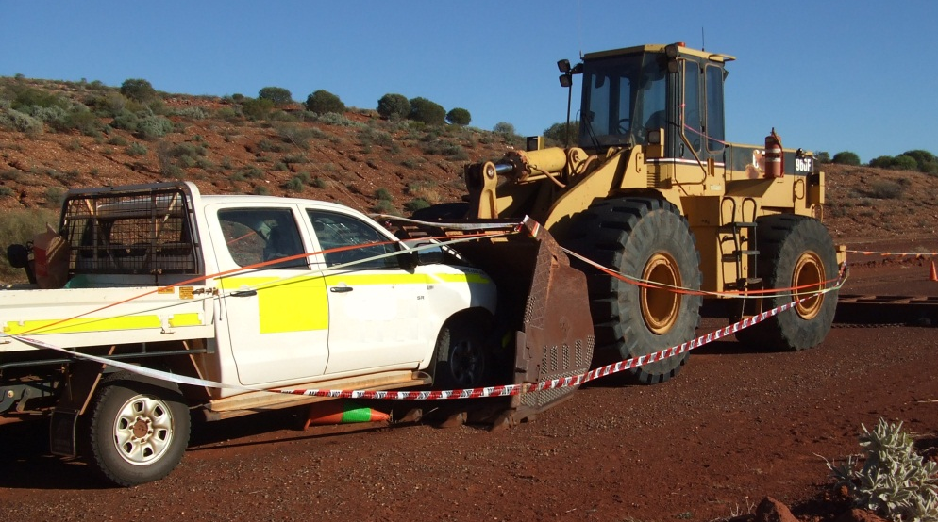
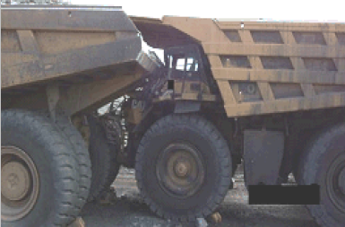
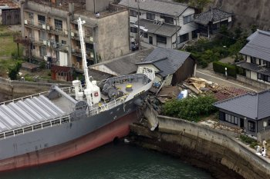
Why is addressing fatigue important?
Notes:
Fatigue can lead to:
errors and accidents
ill-health and injury
reduced productivity
Top two photos are mining examples.
Fatigue is often a root cause of major accidents. Some international examples are:
Herald of Free Enterprise – ferry that capsized after leaving Belgian port of Zeebrugge in 1987, killing 193 passengers and crew. Her bow-door had been left open.
Chernobyl – cause of 1986 disaster partially attributed to human error caused by confusion and fatigue. The effects are still being felt to this day.
Shin Tsunetoyo Maru, Fukuyama, Japan – in 2004, a drowsy skipper ran his 498 tonne freighter into houses on shore while the autopilot was on. Homes were damaged but fortunately only one person was injured – although not so fortunate for him. [outcome shown in bottom photo]

Slide 6

So what can we do about it?
Hazard – prevent, manage
Do not underestimate risks
Duty of care
  employers
  employees
Notes:
It is important not to underestimate the risks of fatigue and understand that fatigue needs to be managed, as for other hazards.
Fatigue is unusual in that not all of the risk factors can be controlled at the workplace.
The legal duty is on employers to manage risks from fatigue, irrespective of any individual’s willingness to work extra hours or preference for certain shift patterns for social reasons.
Employees have a duty to ensure that they are fit for work – well rested, adequate sleep.

Slide 7
Which shift schedule is best?
No single optimal shift system that suits everyone
Diverse work
Diverse workplaces
Diverse people
Notes:
One of the most frequently asked questions is about shift schedules.
There are many different shift work-schedules and each schedule has different features.
This sheer diversity of work and workplaces means that there is no single optimal shift system that suits everyone.
However, a planned and systematic approach to assessing and managing the risks of shift work can improve the health and safety of workers.

Slide 8
What about scheduling?
Optimal shift system for your workplace
Workload
Shift timing
Shift duration
Direction of shift rotation
Number and length of breaks during and between shifts
Notes:
Here are some key risk factors in shift schedule design that should be considered when assessing and managing the risks of shift work.
These are the workload, the work activity, shift timing and duration, direction of rotation and the number and length of breaks during and between shifts.
Other features of the workplace environment such as the physical environment, management issues and employee welfare can also contribute to the risks associated with shift work.

Slide 9
What are some key management principles?
Consult employees on working hours and shift patterns
Develop a policy that specifically address risk factors and guards against fatigue (i.e. prevention rather than control)
Implement policy then monitor and enforce it
Review following assessment of:
  adequacy of resourcing and staffing levels
  effect of changes to working hours
Employer-provided accommodation
  conducive to sleep during night and day
Notes:
Discuss

Slide 10
What is consultation like at your workplace?
Is the workforce (e.g. safety and health representatives) consulted when policies and procedures are:
  being developed?
  being reviewed and revised?
Is the workforce consulted when there are changes to:
  the workplace?
  systems of work?
Notes:
Discuss

Slide 11
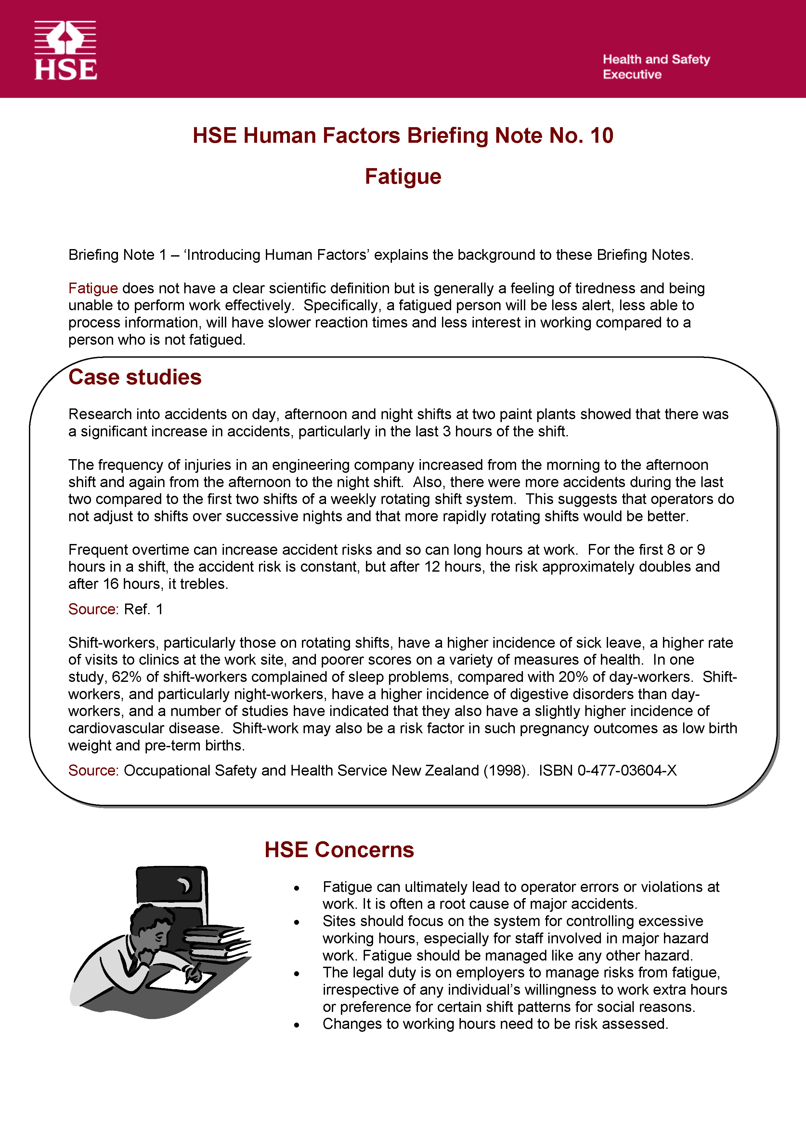
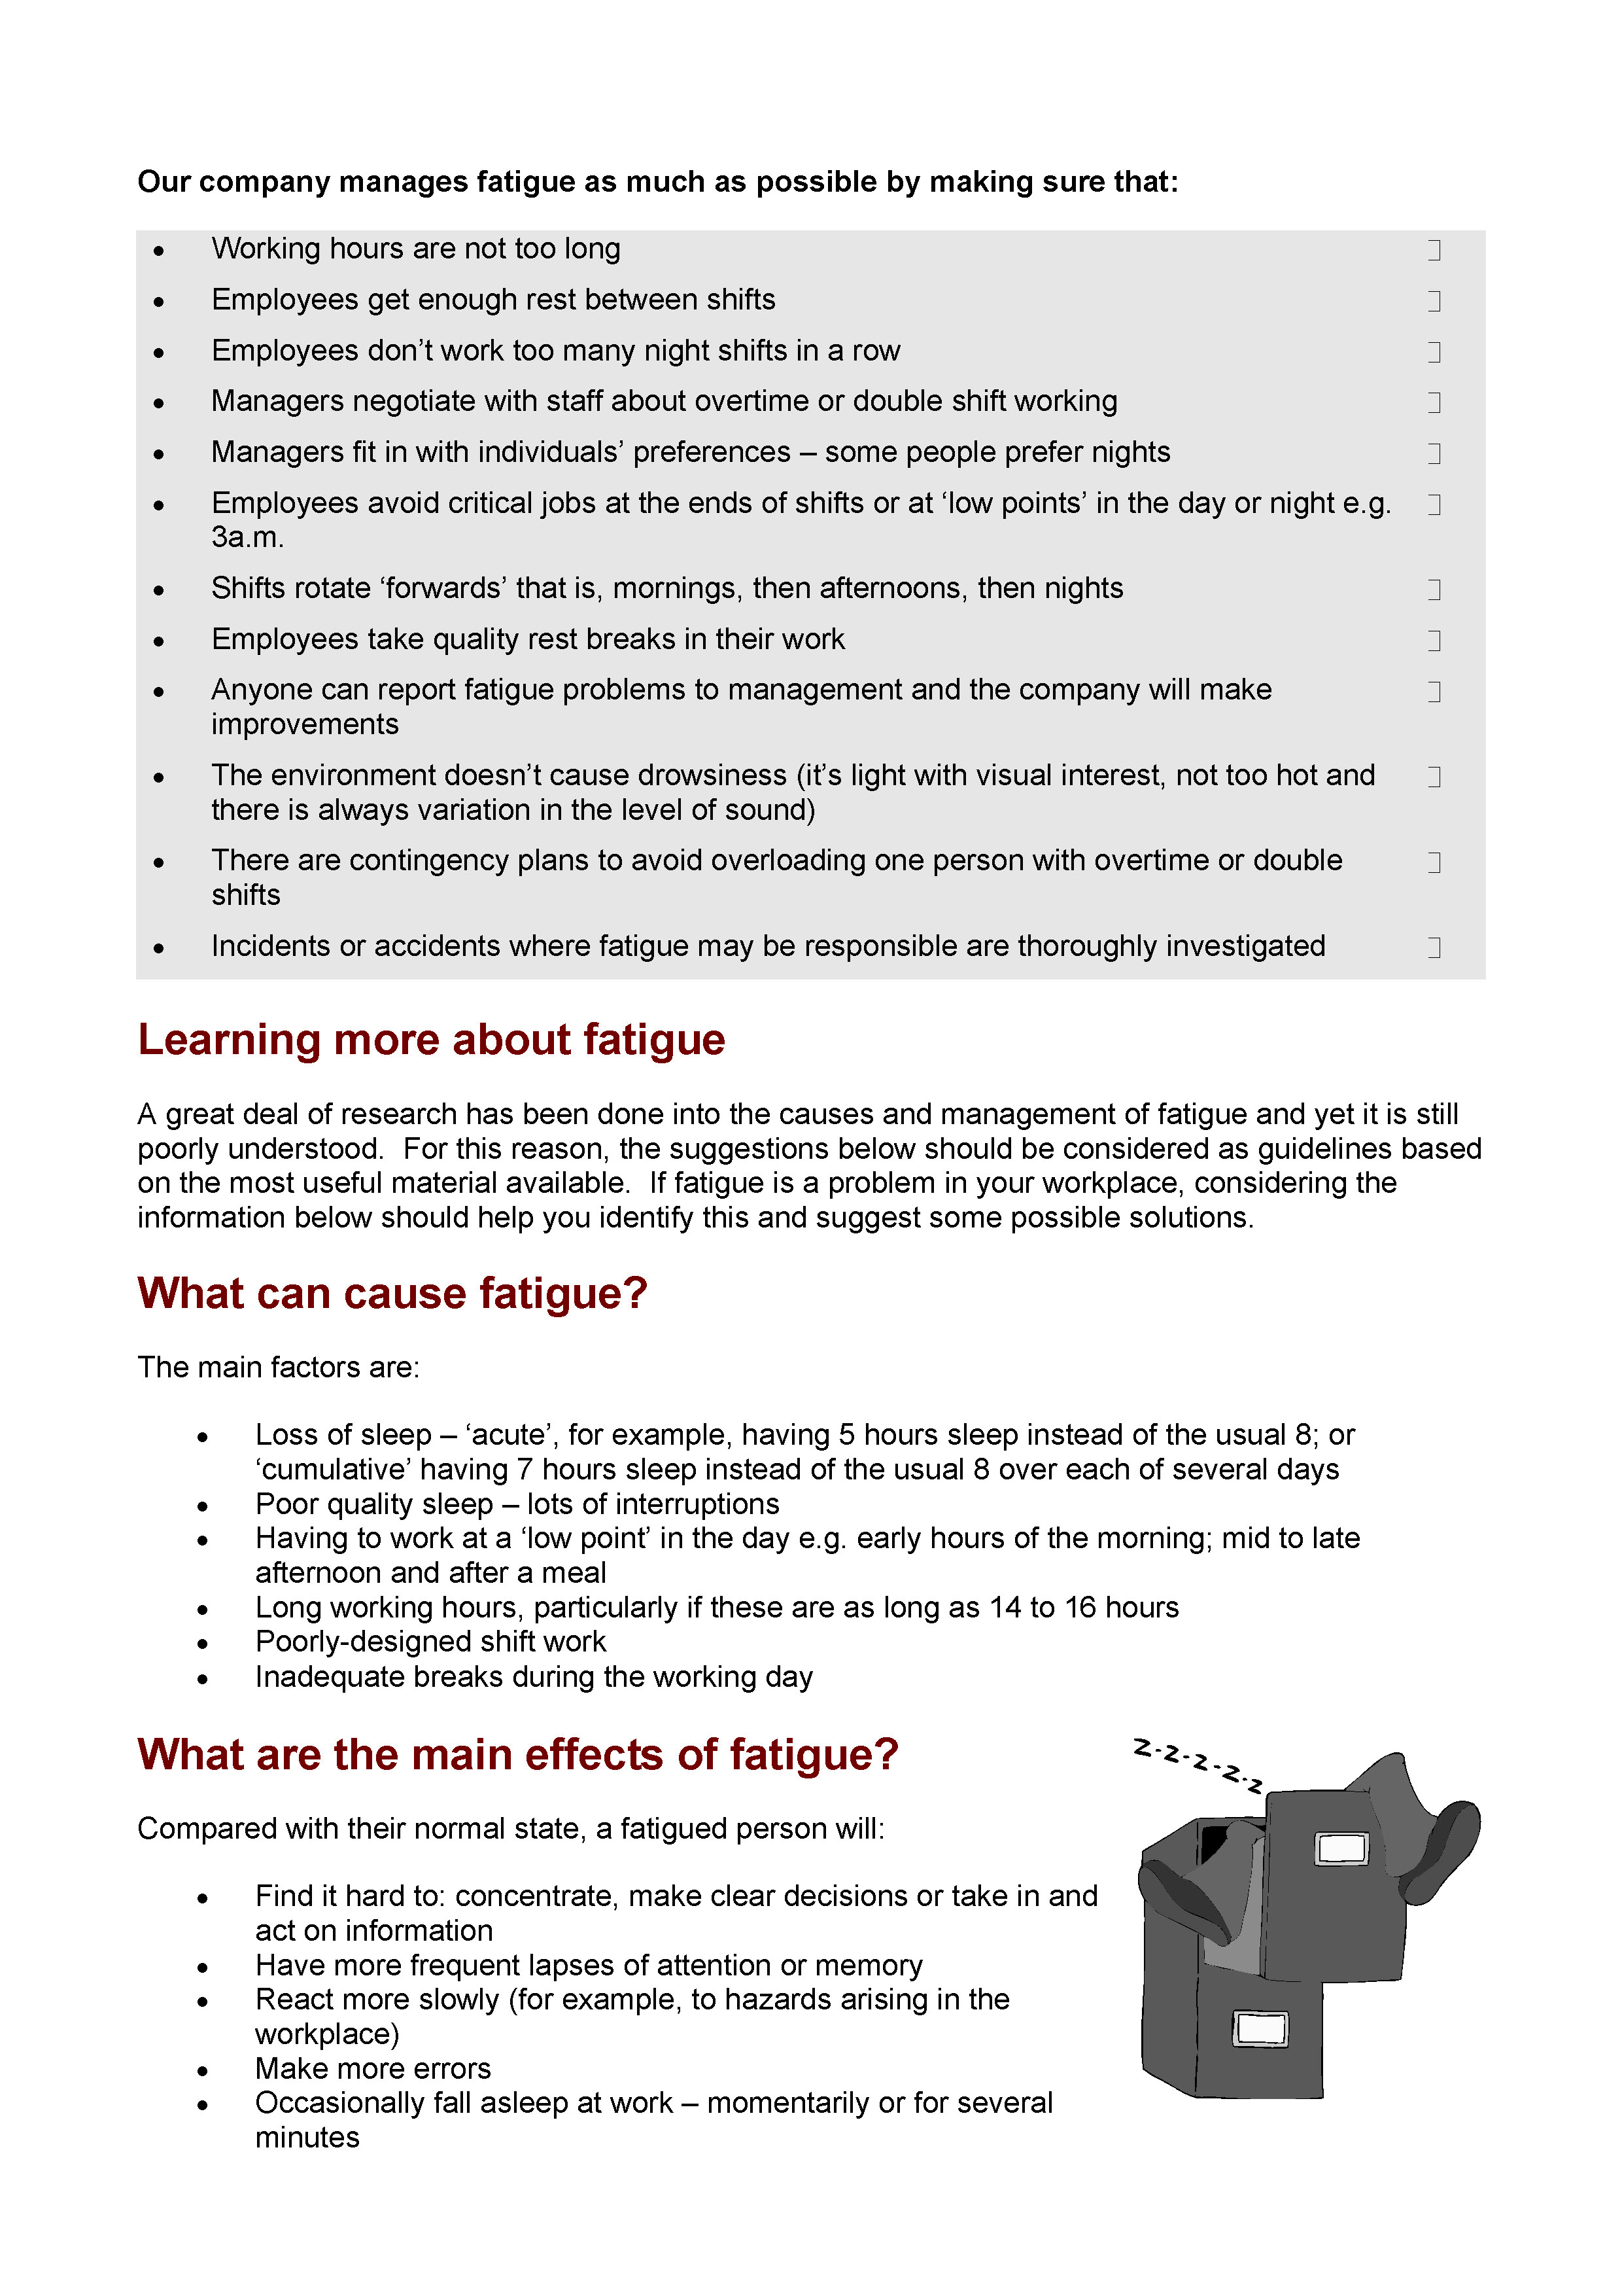
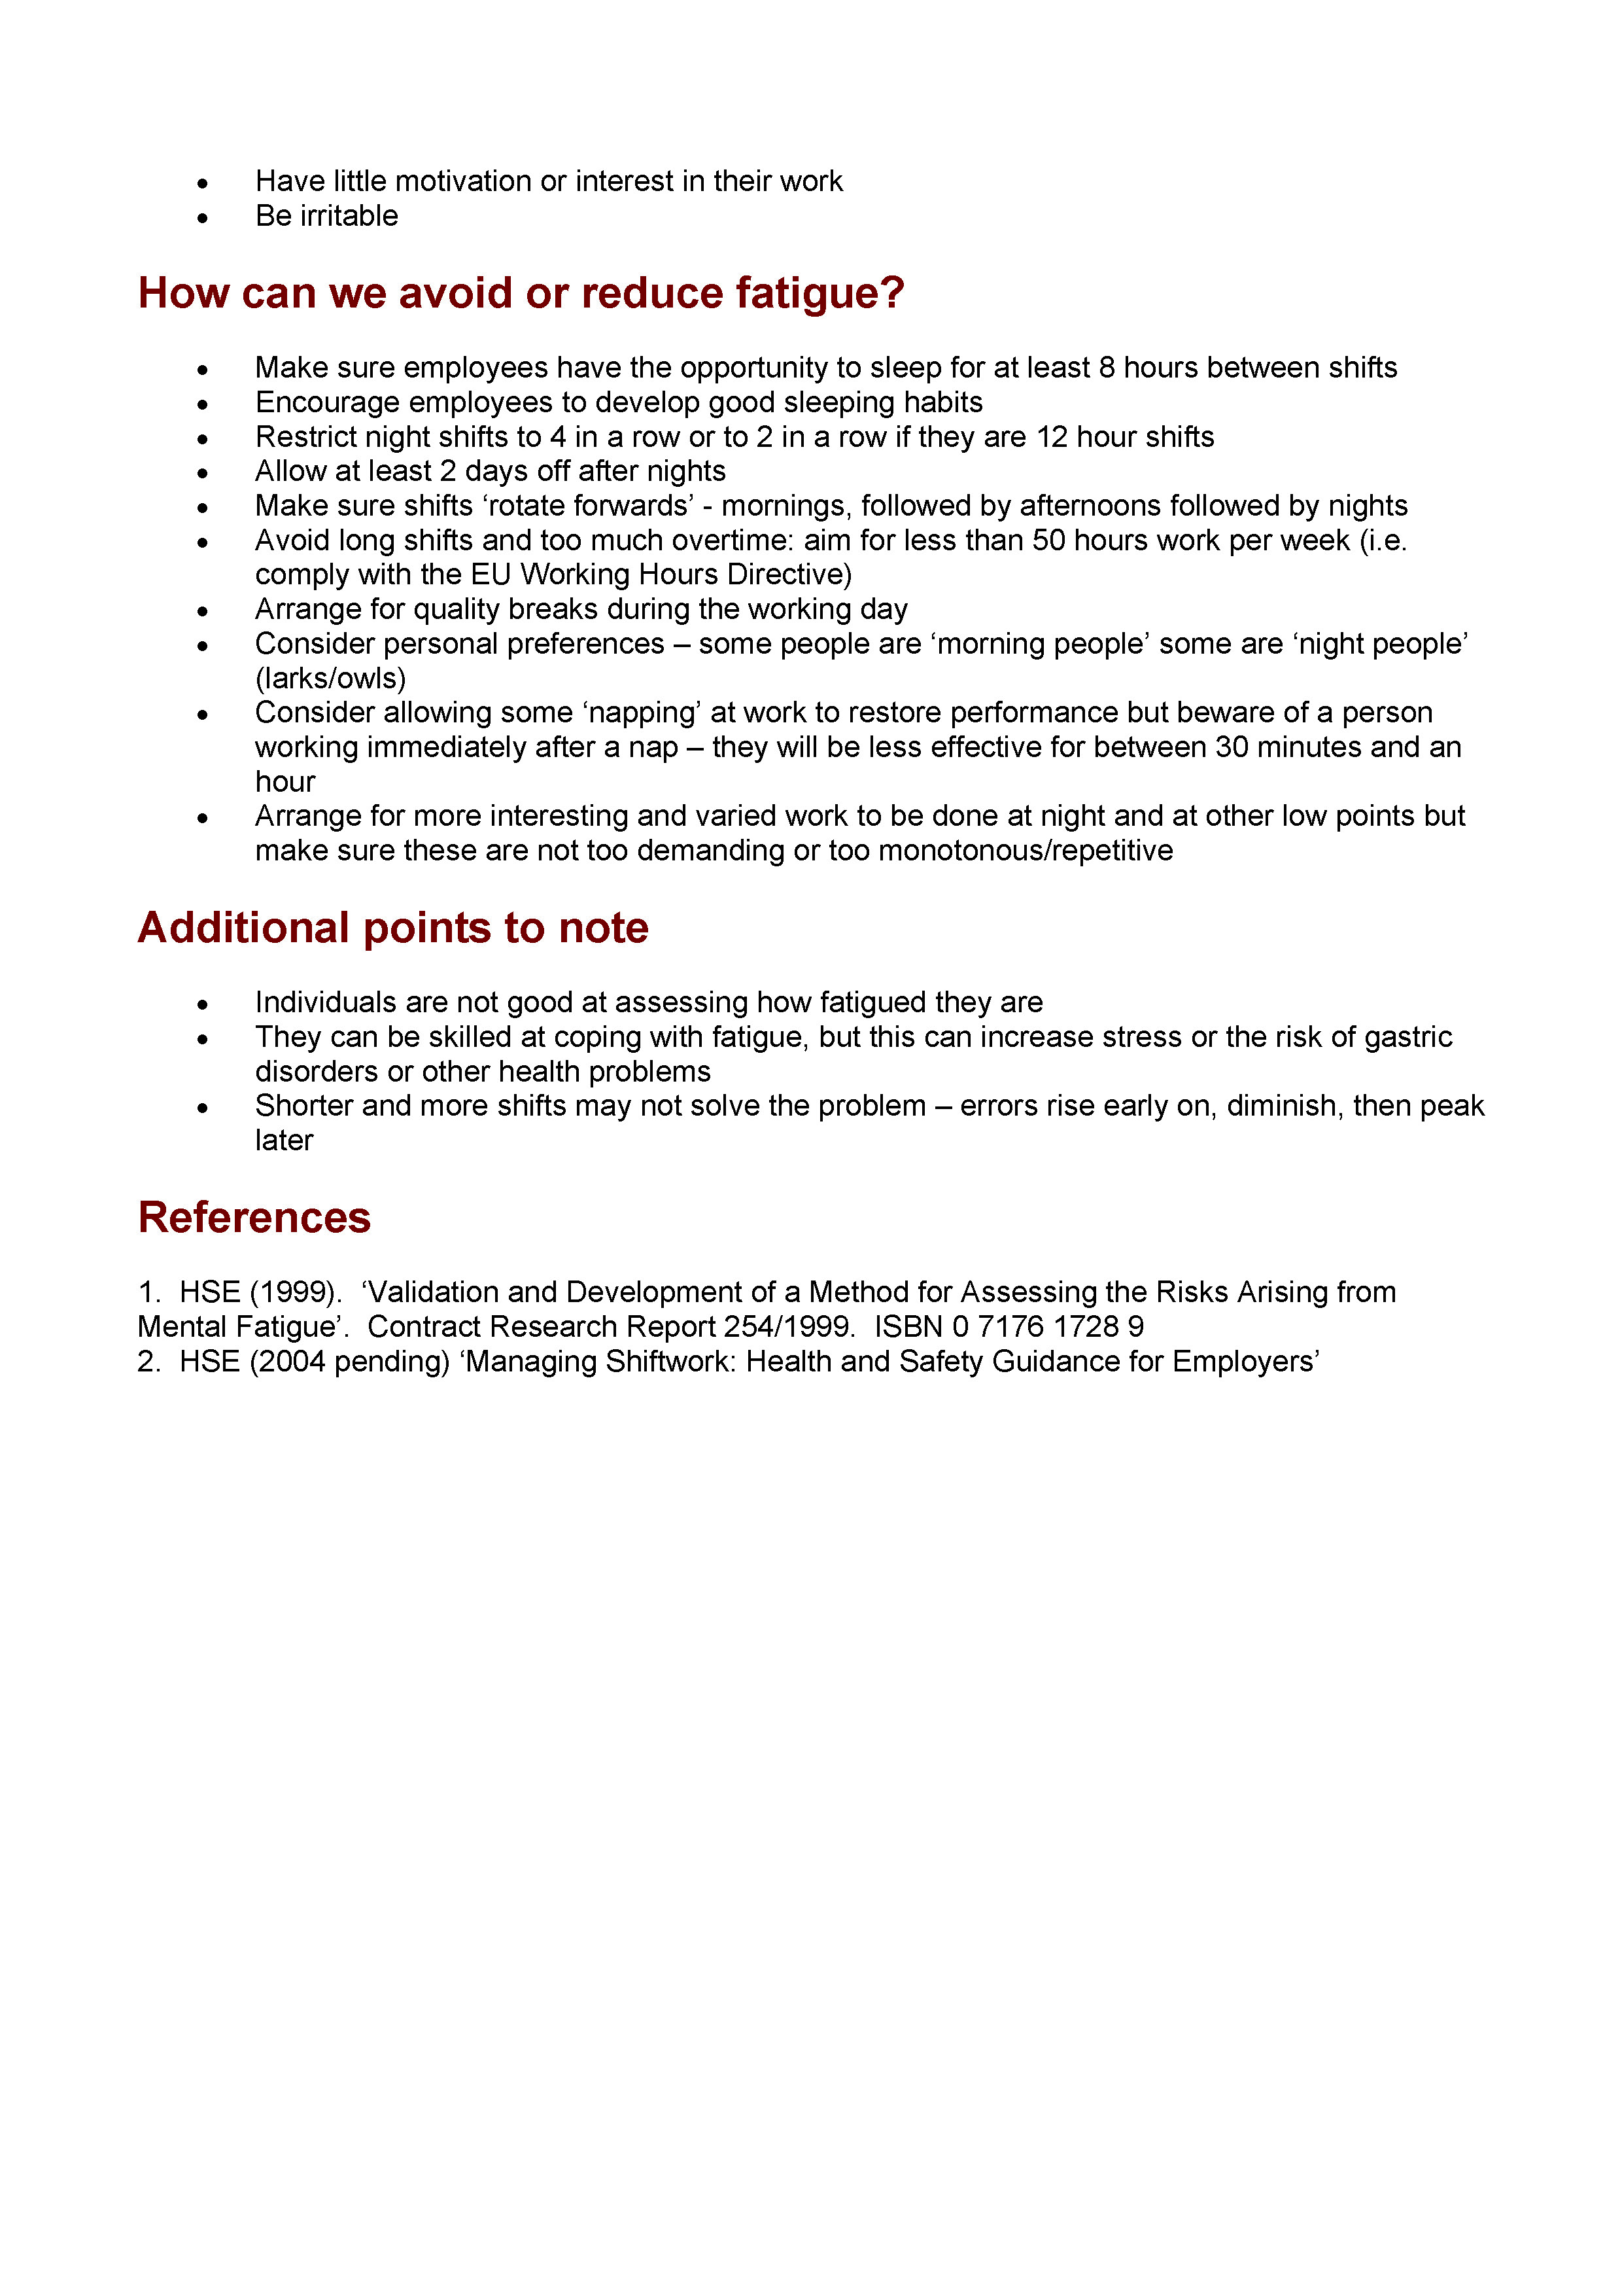
How is your site doing?
See page 2 of HSE Human Factors Briefing Note 10
Notes:
2-3 minutes to complete the checklist on page 2 of the HSE Human Factors Briefing Note 10.
[PROVIDE AS HANDOUT – available at www.hse.gov.uk/humanfactors/topics/10fatigue.pdf]

Slide 12

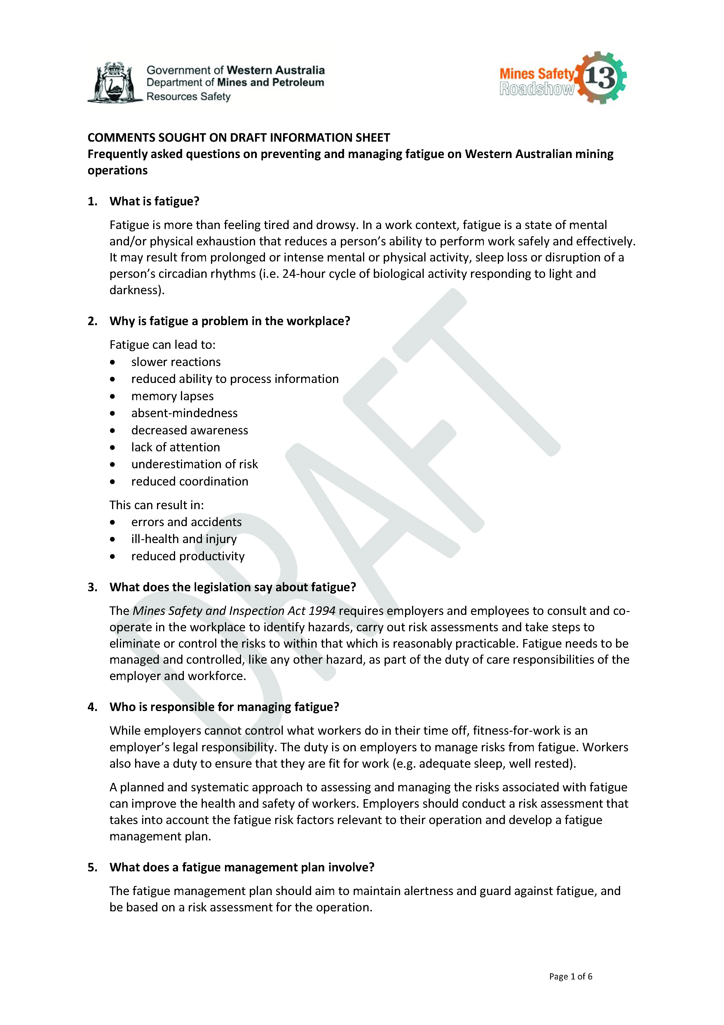
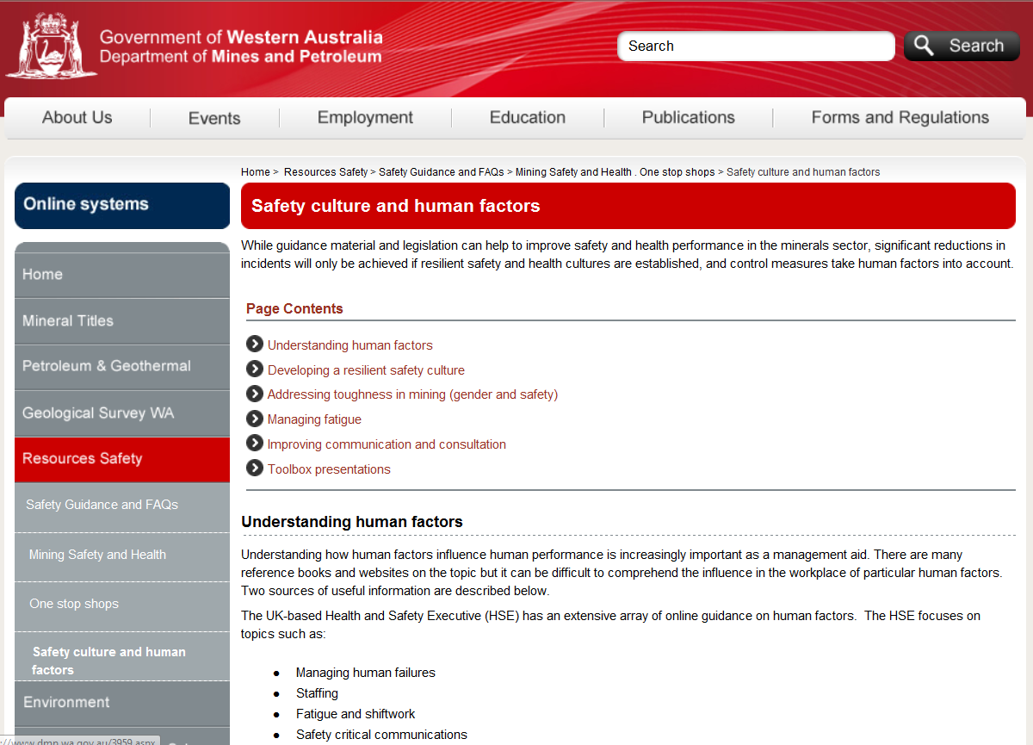
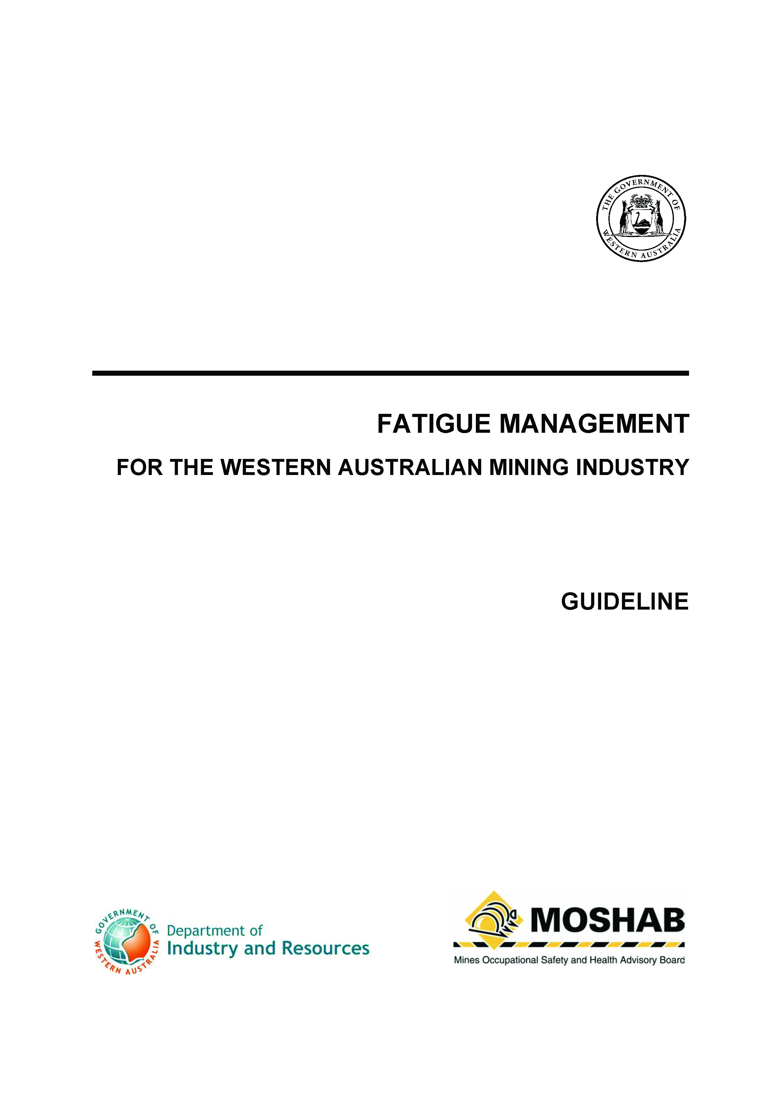
Resources Safety’s current guidance
Have you seen them?
read them?
used them?
http://www.dmp.wa.gov.au/16259.aspx
Notes:
Resources Safety has developed a one-stop-shop for fatigue containing guidance materials and links to other relevant information.
A new FAQ information sheet on fatigue has been developed and reviewed in consultation with participants at the 2013 Mines Safety Roadshow, and replaces the guideline published in 2000.
The fatigue one-stop-shop can be found on the DMP website at www.dmp.wa.gov.au/16259.aspx

Slide 13

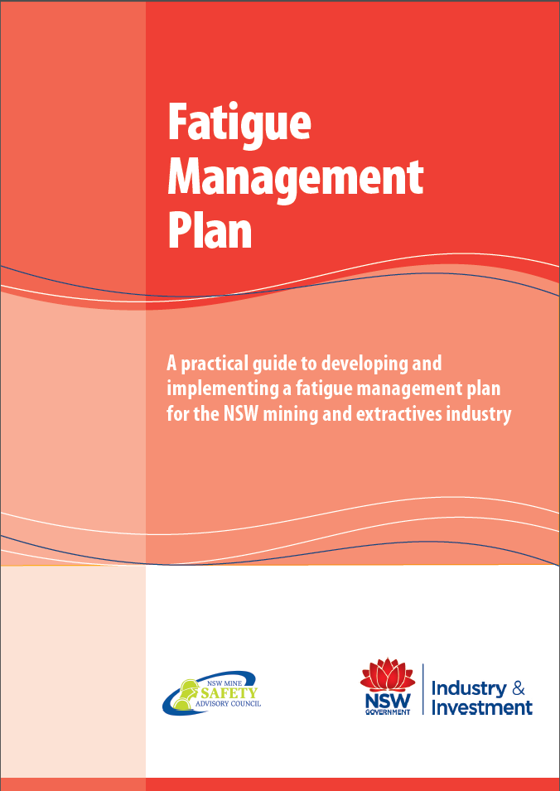
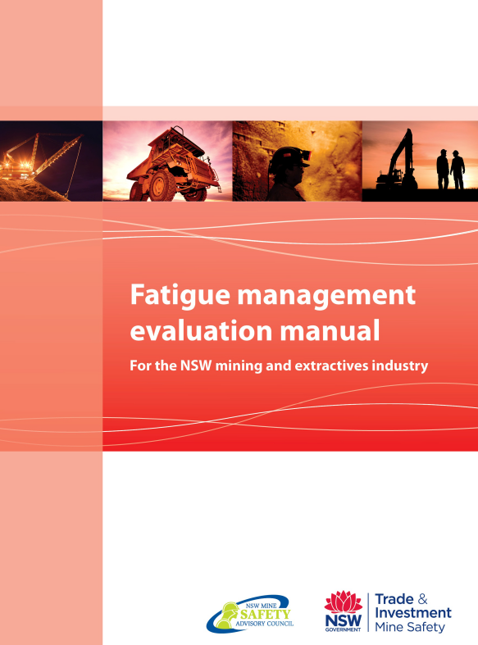
Suite of resources
Notes:
The NSW Government has a package of resources, including a guide to the development and implementation of a fatigue management plan and training material.
This information is available at www.resources.nsw.gov.au/safety/world-leading-ohs/fatigue

Slide 14

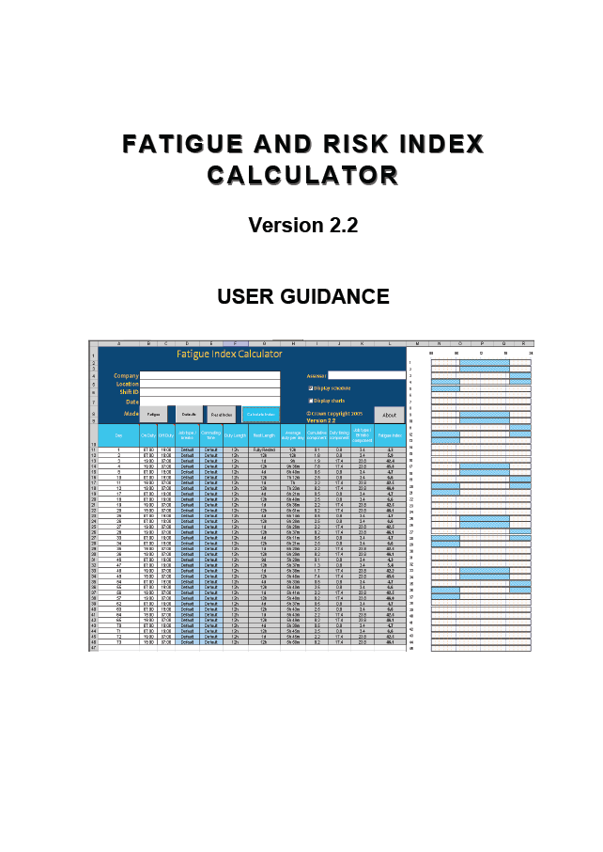
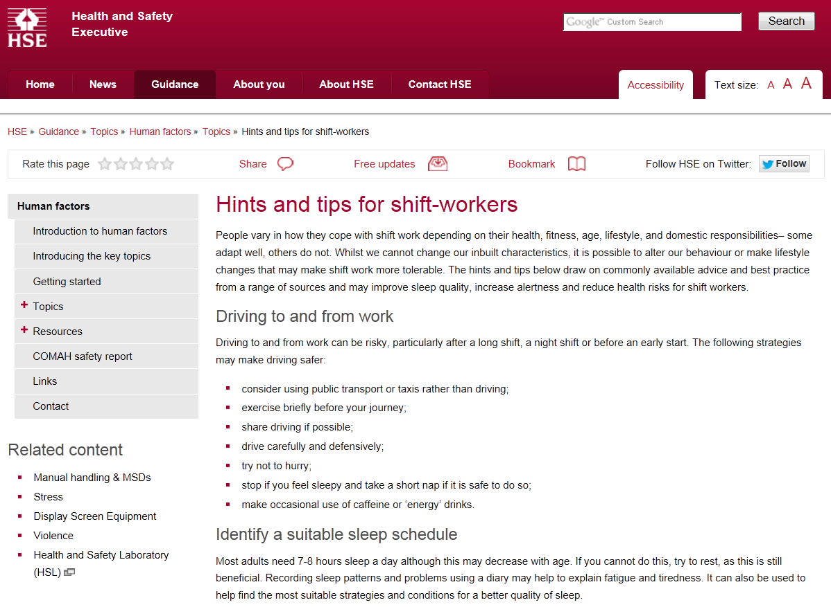
What other guidance is available?
UK-based Health and Safety Executive (HSE) and Energy Institute
Notes:
There is a lot of information available online and in publications. The difficulty can be in knowing where to start!
The UK-based Health and Safety Executive (HSE) [www.hse.gov.uk/humanfactors/topics] and Energy Institute [www.energypublishing.org/browse-by-topic/topic-9] have an extensive array of online guidance on human factors, including fatigue and shiftwork.

Slide 15
Fatigue prevention and management
Affects all of us
Involves all of us
Unlike almost all other hazards at our workplace, is affected by external risk factors
Is our fatigue management plan adequate?
Are you fit for work?
Notes:
If you are continually fatigued and nothing seems to work, speak to your manager or supervisor.
Also consider a health check to confirm there are no underlying medical conditions such as sleep apnoea or diabetes.
Discuss

