Slide 1
Please read this before using presentation
This PowerPoint has been produced for the public and is made available for non-commercial use (e.g. toolbox meetings, OHS discussions) subject to the condition that the PowerPoint file is not altered without permission from Resources Safety.
For resources, information or clarification, please contact:
  RSDComms@dmp.wa.gov.au
  or visit
  www.dmp.wa.gov.au/ResourcesSafety

Slide 2


Regulator’s role in supporting positive cultural change to enhance safety management in mining
www.dmp.wa.gov.au/ResourcesSafety

Slide 3
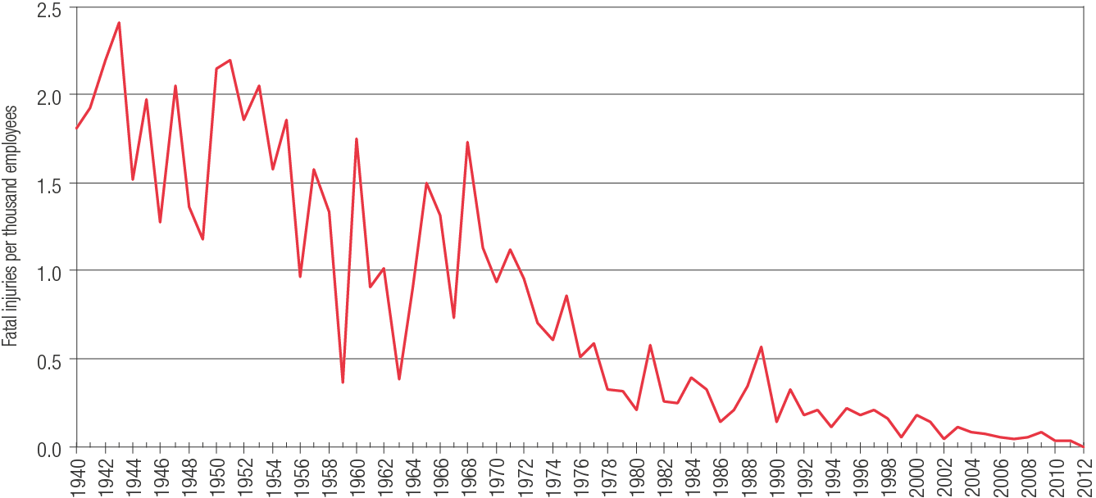
Fatal injury incidence rate
Notes:
This graph tracks the decreasing trend of the fatal injury incidence rate in WA. In 2012 there were no reported deaths.

Slide 4

Zero fatalities
Zero harm
Notes:
So if there was zero fatalities does this mean there was no harm?

Slide 5
Number of serious injuries per million hours worked
Closing the gap
Notes:
Animation
Click: closing the gap sign and red line appears
This graph shows the frequency rate for serious injuries across mine sites and exploration in Western Australia. The rate has been going down over the past 15 or so years, and seems to be flattening out, although there is a slight downward trend that we hope continues.
Previously, the focus when attempting to improve safety outcomes was to work on engineering and system controls, and rightly so. But if we want the next step-change, to drive the frequency rate towards zero, then we need to consider the human factors – and what the workplace is like in terms of safety culture.

Slide 6
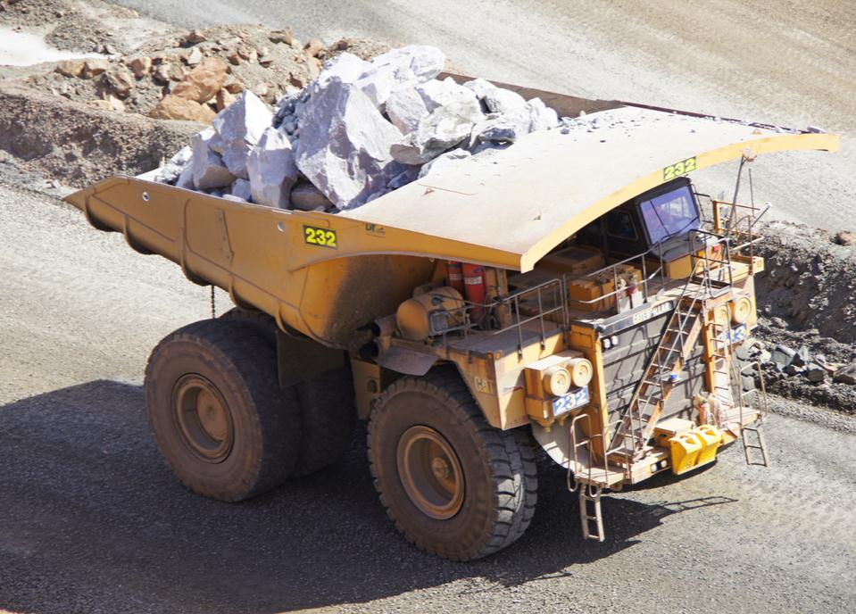

Benefits of RADARS for the resources sector
A commitment to working with the sector to reduce serious accidents and incidents, and provide tangible support in achieving a positive cultural change
.
Notes:
While industry has its role to play, so does Resources Safety as the mines safety regulator.
RADARS = Reform and Development at Resources Safety, a strategy initiated in early 2010.
What does RADARS mean for industry?
The emphasis is on reducing the number and severity of incidents.
From Resources Safety’s perspective, it is a balance between promoting safety outcomes, monitoring compliance and enforcement to improve the delivery of regulatory services.
There is a commitment to working with industry to develop resilient safety cultures as the “norm”.

Slide 7
Safety culture spectrum
Vulnerable | Rule followers | Robust | Enlightened | Resilient
In denial Messengers ‘shot’ Whistleblowers dismissed or discredited Protection of the powerful Information hoarded Responsibility shirked Failure punished or covered up New ideas crushed | Deal ‘by the book’ Conform to rules Target = ‘zero’ Reactive Repair not reform Information neglected Responsibility compartmentalised New ideas = ‘problems’ | Develop risk management capacity Enhance systems Improve suite of performance measures Develop action plans Monitor and review progress Clarify/refine objectives | Active leadership Safety management plan widely known Competent people with experience Accountabilities understood Advanced performance measures Regular reviews Range of emergency responses catered for | Strive for resilience of systems Reform rather than repair Responsibility shared Actively seek new ideas Messengers rewarded Proactive as well as reactive Failures prompt far-reaching inquiries Flexibility of operation Consistent mindset is ‘wariness’
‘in disarray’ pathological | ‘organised’ reactive | ‘credible’ calculative | ‘trusting’ proactive | ‘disciplined’ generative
Sanction | Direct | Encourage | Partner | Champion
Notes:
What does the regulator mean by a resilient safety culture?
Here is the safety reform spectrum.
It lists the attributes of different organisations – starting with the most prone to failure on the left and moving across in increasing levels of trust and system development.
The row across the bottom shows the ways in which regulators tend to vary their strategies to deal with these types of organisations.
Clearly, all operations should aspire to be RESILIENT.
What are the attributes of a resilient safety culture:
To strive for resilience of systems you must be able to take a hit and recover e.g. Receive negative feedback and react proactively .
Reform rather than repair. If something goes wrong, or almost does, then take the opportunity to really address the issues using the hierarchy of control rather than do a “quick fix”
Responsibility shared, every employee on the mine is responsible for safety not just safety reps, safety advisors and management.
Seek new ideas, is there a better way of doing what we are doing.
Messengers rewarded with positive feedback/recognition.
Proactive as well as reactive, use audit findings/consult the workforce to proactively deal with hazards prior to an event
Failures prompt far reaching inquiries and not just blaming the operator.
Flexibility of operation to overcome and resolve issues.

Slide 8
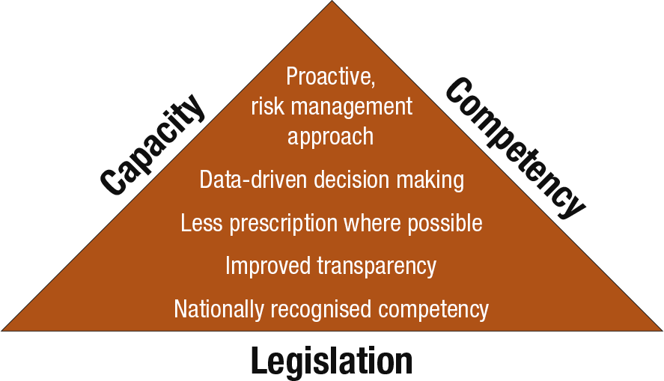
What is the vision for leading practice regulation?
Notes:
How do we use all the information we have to become one of the leaders in safety regulation?
The RADARS strategy has been focused on increasing our capacity and competency to deal with issues and situations.
Let’s look at the three elements of the triangle.
Legislation – continuing to emphasise and improve risk management approach – is it adequate and achieving the best results?
Capacity – ensuring there are sufficient resources (e.g. personnel, online systems, education and information) to implement compliance strategies – how many staff are required to do the job properly? Can we improve the way that information is submitted and handled (the simpler it is, the better). Can we do more with the data we have? And what sort of resources are required by industry to increase compliance and improve safety performance?
Competency – ensuring staff have necessary technical, audit and communication skills (staff who can do the job well, not just in terms of technical skills but dealing with people in industry).
So what is Resources Safety’s approach to safety compliance in a practical sense?

Slide 9
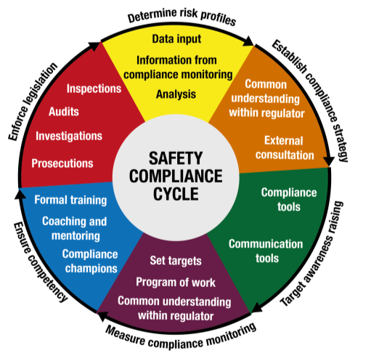
Two approaches to achieve safety compliance
Seek compliance and enforce legislation
Raise awareness
Notes:
As a safety regulator, there are two main ways that Resources Safety interact with industry.
Firstly, raising awareness of safety and health matters within the industry. People need to be aware of their roles and responsibilities, and understand what they need to do to ensure that their workplace is safe.
Secondly, there is the traditional role of the inspectorate, which is to enforce the legislation, although auditing is also very effective as a proactive tool.
Let’s have a closer look at how you can take advantage of these approaches in your workplace.

Slide 10
Teamwork is the key
Variety of industry experience and skills
In-depth training to address hazards and risks within regulatory framework
Proactive and planned work programs to address priority issues
Encourage contact with managers, supervisors and safety and health reps during site visits
May be no prior notification when investigating complaints or specific safety issues and concerns
Notes:
So how is the mines inspectorate operating today?
Under the RADARS strategy, Resources Safety has attracted and retained industry people with a variety of experience and skills, and a commitment to making a difference to WA mining.
Training is provided to ensure inspectors are equipped for their roles, and there is a consistent approach to the application of legislation.
For more effective delivery of regulatory services, work programs focus on the issues and workplaces most at risk of adverse outcomes. Visits are coordinated, typically with 2 or 3 inspectors with complementary skills to match the type of operation. This approach should add value and reduce duplication should issues arise during an audit or inspection.
Communication and consultation usually achieve better results than coercion. And site visits are not only to check compliance, but should be viewed by industry as an opportunity to raise issues and discuss improvements in methodology.
However, inspections may be conducted without warning in some circumstances.
Our ultimate goal though is to work cooperatively with industry to ensure all mine sites across WA comply with the legal requirements when it comes to safety, and support positive cultural change.

Slide 11
Focusing on priority safety and health issues
Focus groups addressing significant and emerging issues
Improve internal systems within the inspectorate – work across regions and disciplines
Develop compliance tools and training to assist inspectors
Provide consistent and transparent information about safety and health issues
Develop appropriate guidance material and other resources for industry
Notes:
Focus groups have been established to deal with a number of significant and emerging issues, such as construction, automation, exploration drilling and working at height underground.
Depending on the group’s aims, group members cut across traditional disciplinary lines and comprise members from the various offices. This encourages sharing and innovation, as well as a uniform approach to regulation across the State.
The focus groups are tasked with taking on projects that benefit the inspectorate as well as industry. This may involve providing training or information to the whole inspectorate, again encouraging an agreed and consistent approach to regulatory matters.
Industry may be involved in the focus group activities through working parties, or participating in workshops and surveys, or provide feedback. This input is critical to ensure that the resource materials provided to industry really do add value.

Slide 12
Supporting cultural change
Gendered behaviours and safety (Toughness in mining)
Mental wellbeing
Prevention and management of fatigue

Slide 13
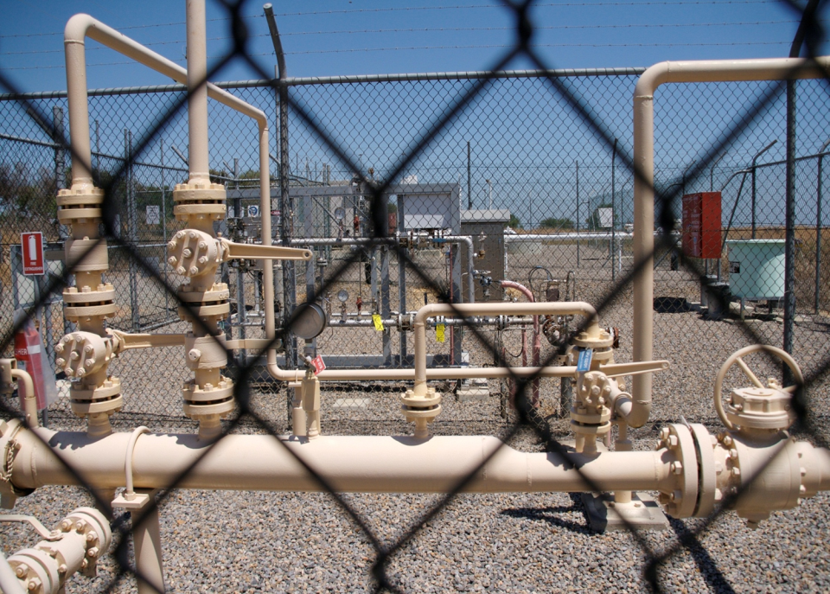
Q. How can you improve safety outcomes?
A. Focus on risk management
Notes:
Animation:
1. Click: Answer ”Focus on risk management” appears

Slide 14
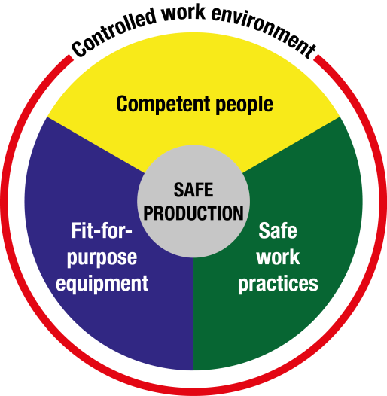
What’s involved in risk management?
Notes:
A useful framework to identify controls is the Nertney Wheel.
Basically it says that safe production relies on good risk management to eliminate or mitigate the risks.
And attention to human factors is critical for good outcomes.

Slide 15
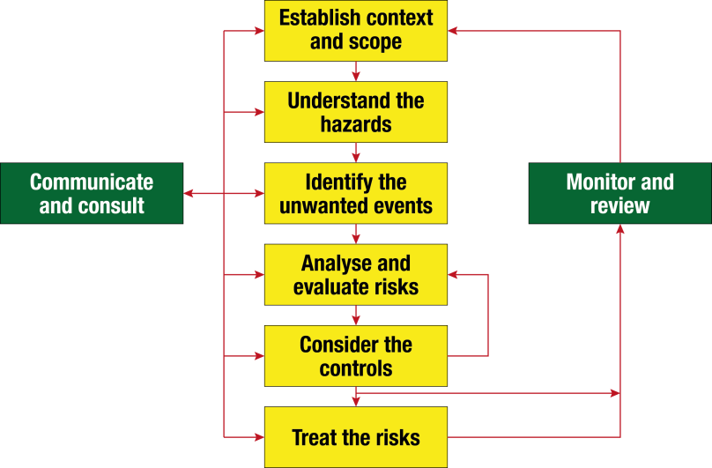
How do we manage risk?
NSW MDG 1010
Notes:
Animation:
Click: red ring appears around “understand the hazards”
Click: blue ring appears around ‘consider the controls”

Slide 16
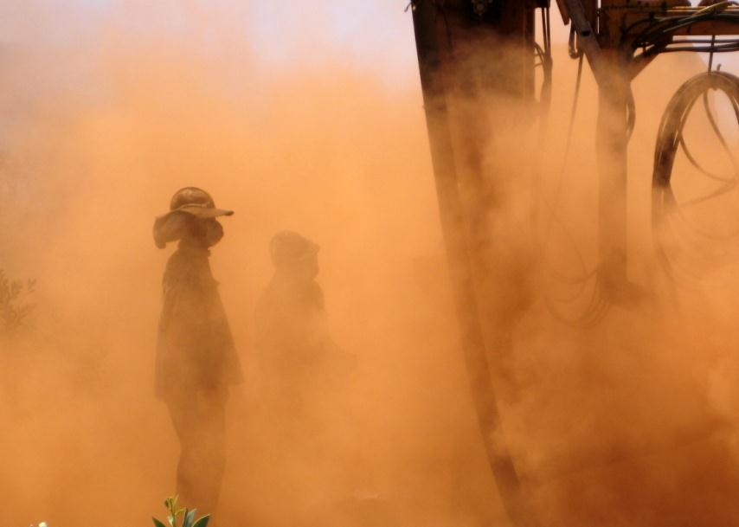
Problems
Not recognising or appreciating the hazard
Playing the numbers game
Not focusing on the controls and their ongoing effectiveness
Ownership of the risk assessment process
Not recognising the right ‘value’

Slide 17
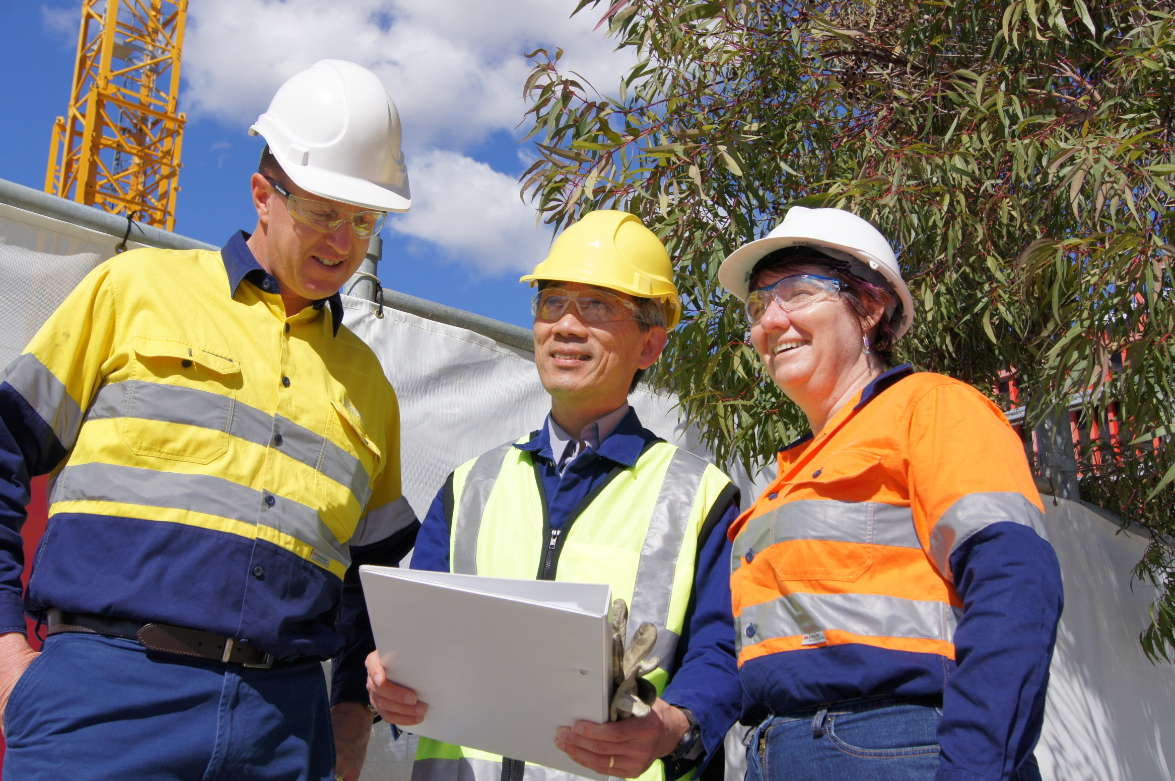
Defining the “value”’
Is SAFETY a value?
Or is it an outcome?
CARING is the value

Slide 18
Risk management and relationships
Your children
Your friends
How much we care about people
Site people
Efforts to protect them
Strangers
How good we are at managing risk
Notes:
Animation
Click: your children appears
Click: your friends appears
Click: strangers appears
Click: site people appears

Slide 19
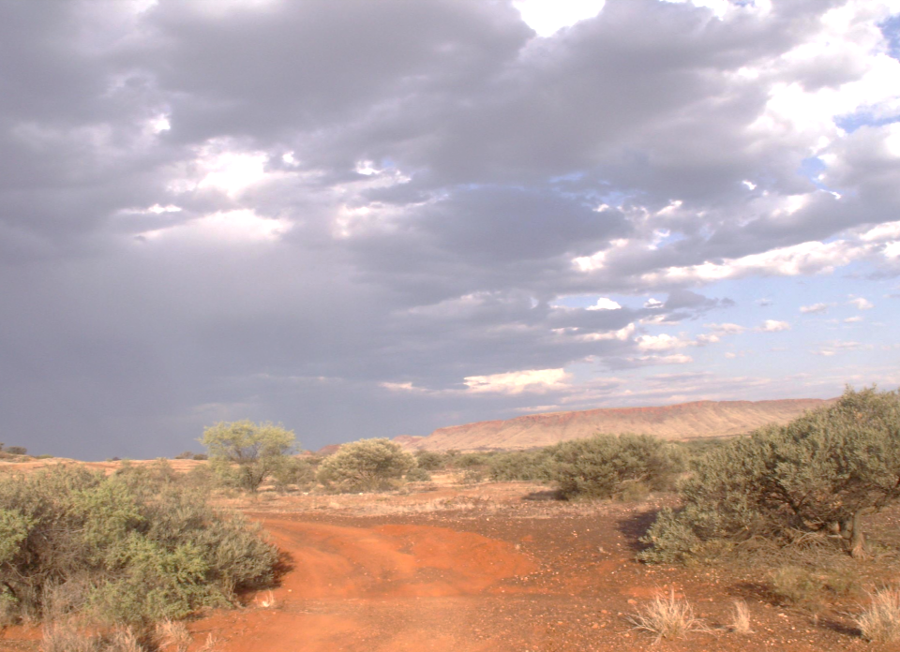
Opportunities for cultural change
Inspections
Investigations
Audits
Communication, consultation
Risk management
Resilience

Slide 20


Stay informed!
Subscribe to our email alert service
and receive weekly news about:
recent publications
latest safety alerts
events
what’s happening at Resources Safety.
Visit www.dmp.wa.gov.au/ResourcesSafety
to sign up
Notes:
If you aren’t already signed up for Resources Safety’s news alert service, do so today. It’s very easy – just provide your name and an email address.
This alert service is the fastest way for us to keep you informed about what’s happening in the world of mines safety regulation.

